Slide 1
Ensemble Methods
Jeff Macaluso
@MacalusoJeff

Slide 2
Slides & Notebook on GitHub
www.github.com/JeffMacaluso/Talks/tree/master/EnsembleMethods

Slide 3




About Me

Slide 4
What are Ensemble Methods and Why Should I Care?

Slide 5
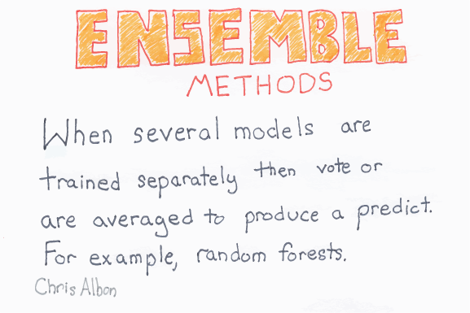

Slide 6
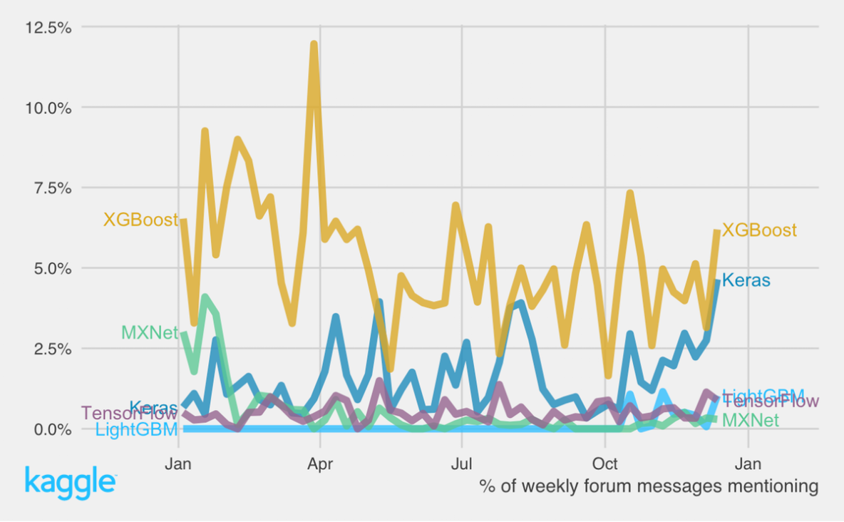
Kaggle: 2016

Slide 7
Why not use XGBoost & Keras for everything?
Interpretability
Computational cost
Training
Inference

Slide 8

No Free Lunch Theorem
“There is no one model that works best for every problem”

Slide 9
However…
Interpretability
Can obtain “relative importance” of features
Computational Cost
Can parallelize some ensemble algorithms

Slide 10
Other Ensemble Method Advantages
Very high predictive performance
Typically more robust to outliers & overfitting
Fewer assumptions
Relatively quick to train

Slide 11
A Quick Re-cap on Fundamentals

Slide 12
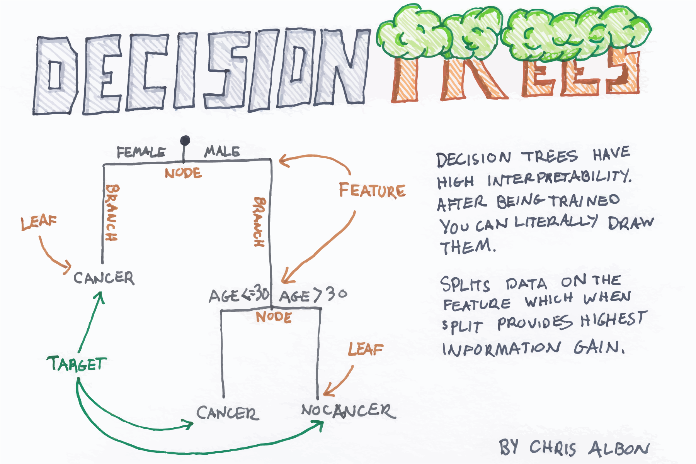

Slide 13
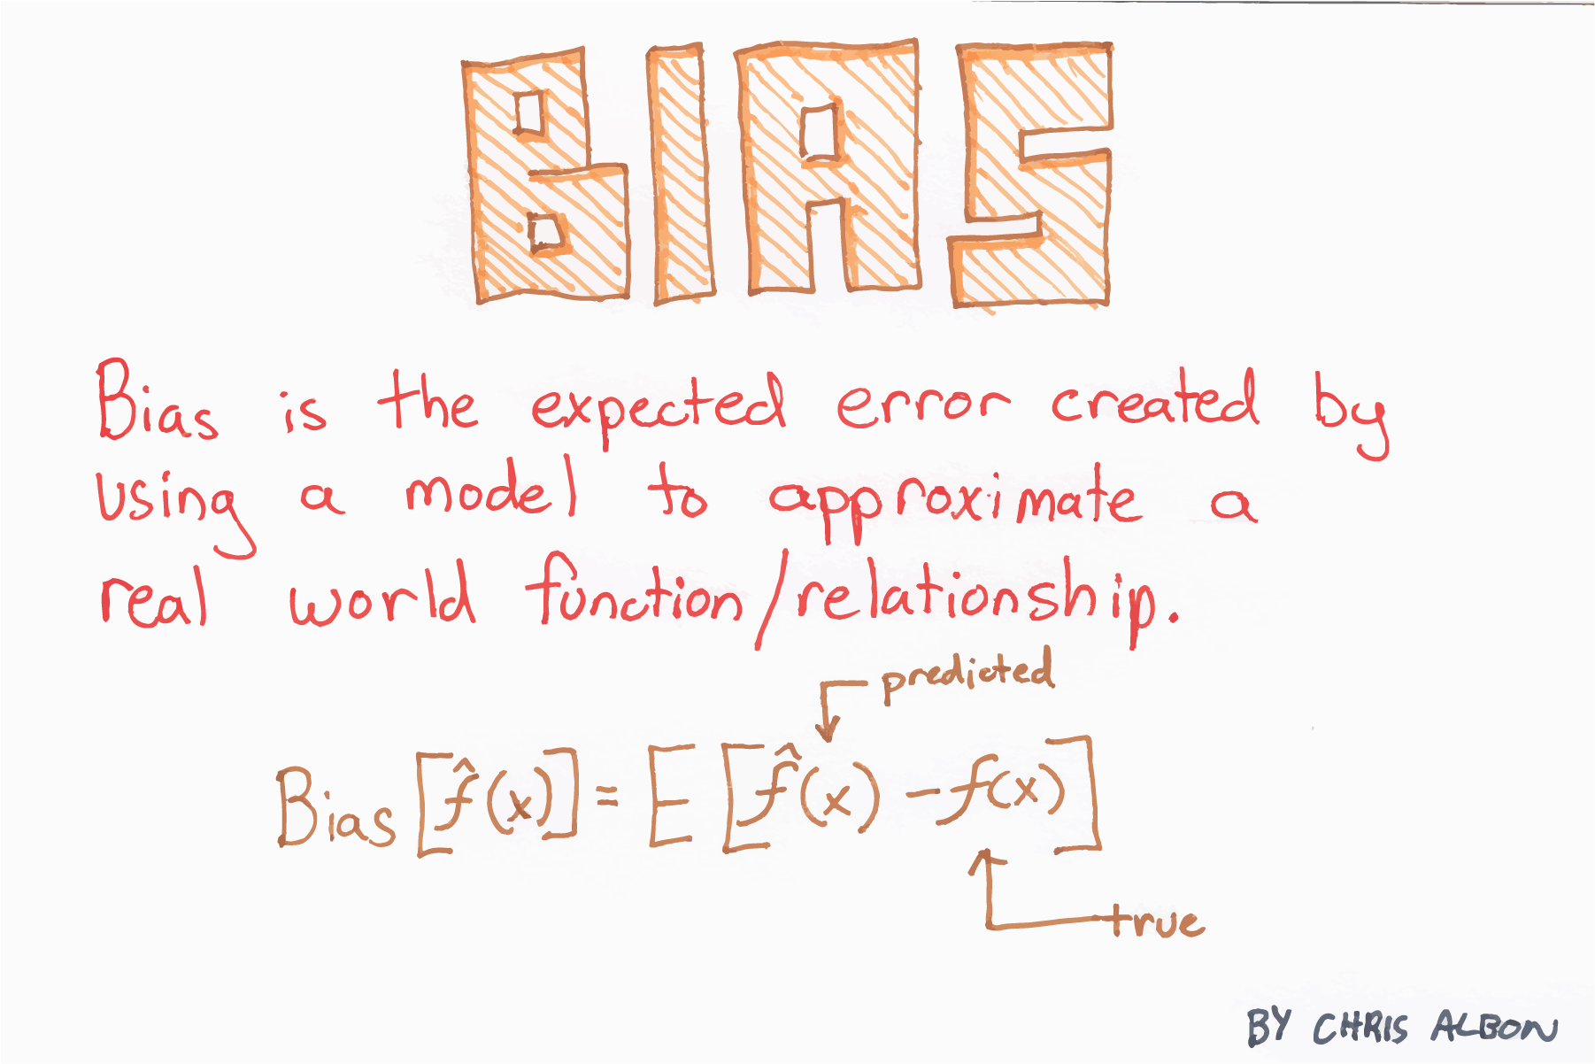
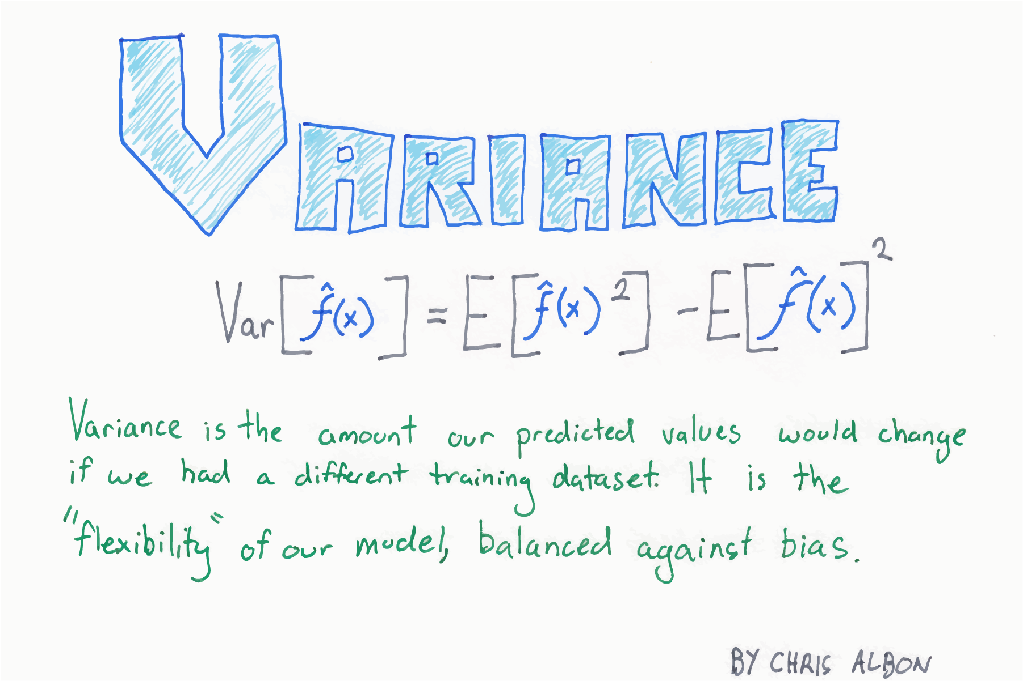
Bias & Variance

Slide 14
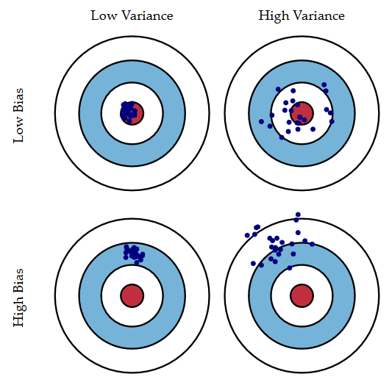
Bias & Variance
Credit: Scott Fortmann-Roe

Slide 15

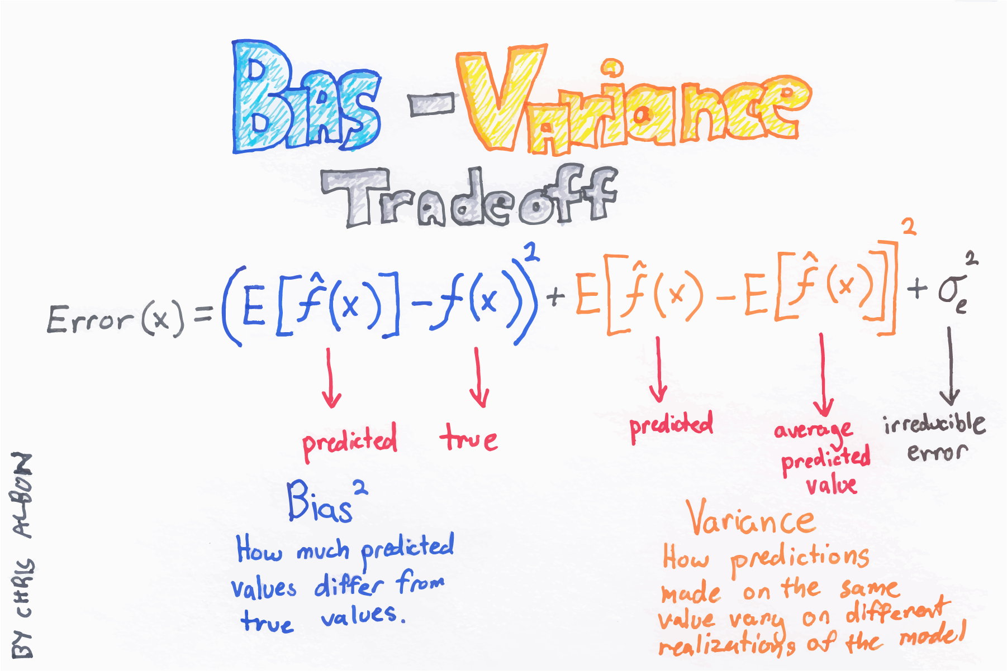
Bias-Variance Tradeoff
Credit: Scott Fortmann-Roe
Credit: Chris Albon

Slide 16
Ensemble Methods

Slide 17
Types of Ensemble Methods
Bagging
Boosting
Stacking

Slide 18
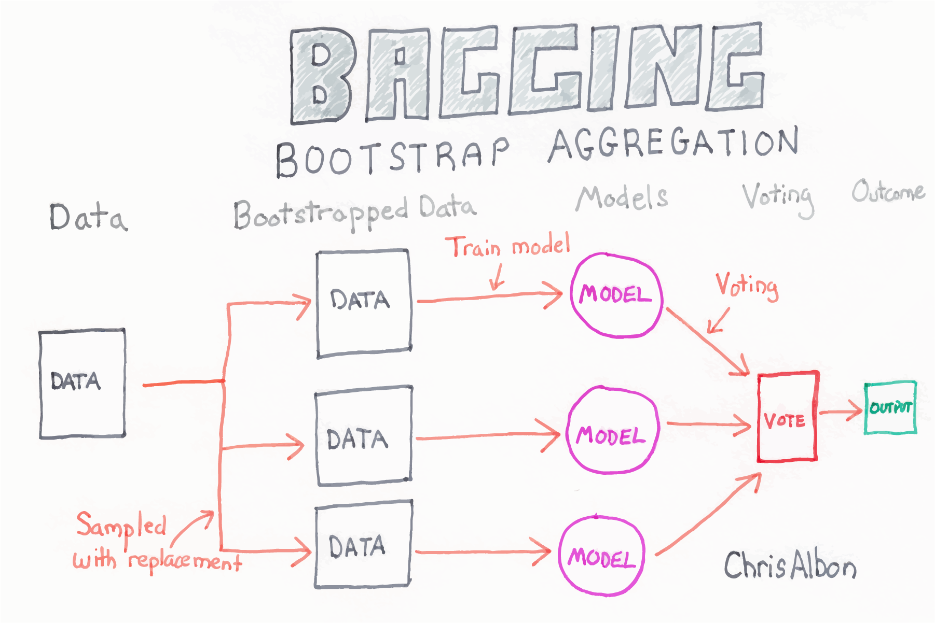

Slide 19
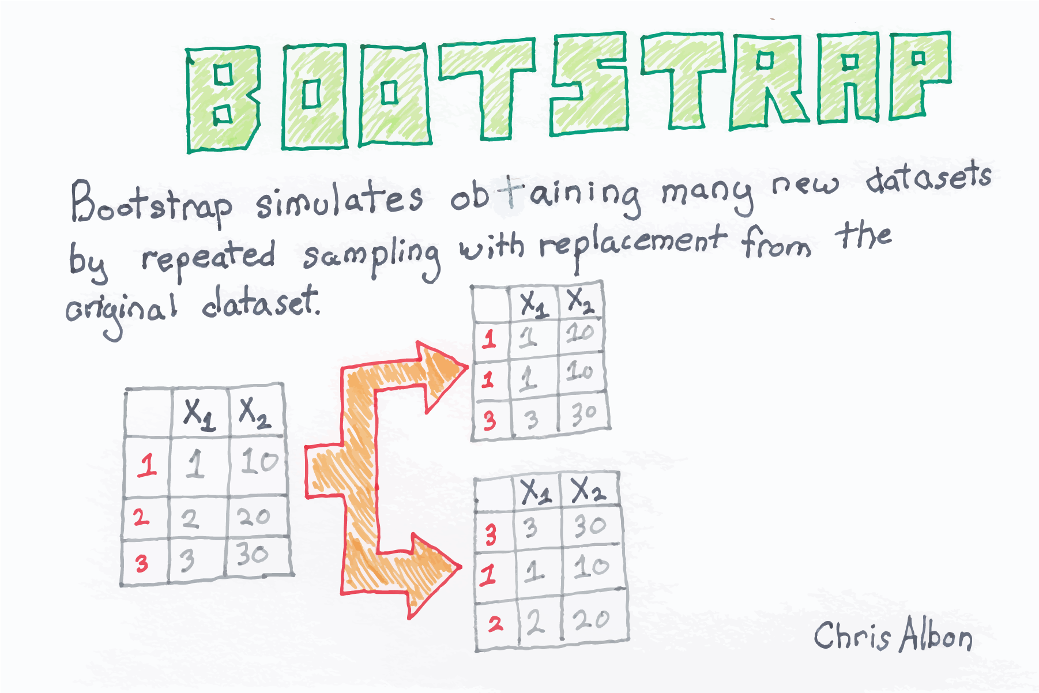

Slide 20
Bagging
Can be built in parallel
Tends to decrease variance

Slide 21
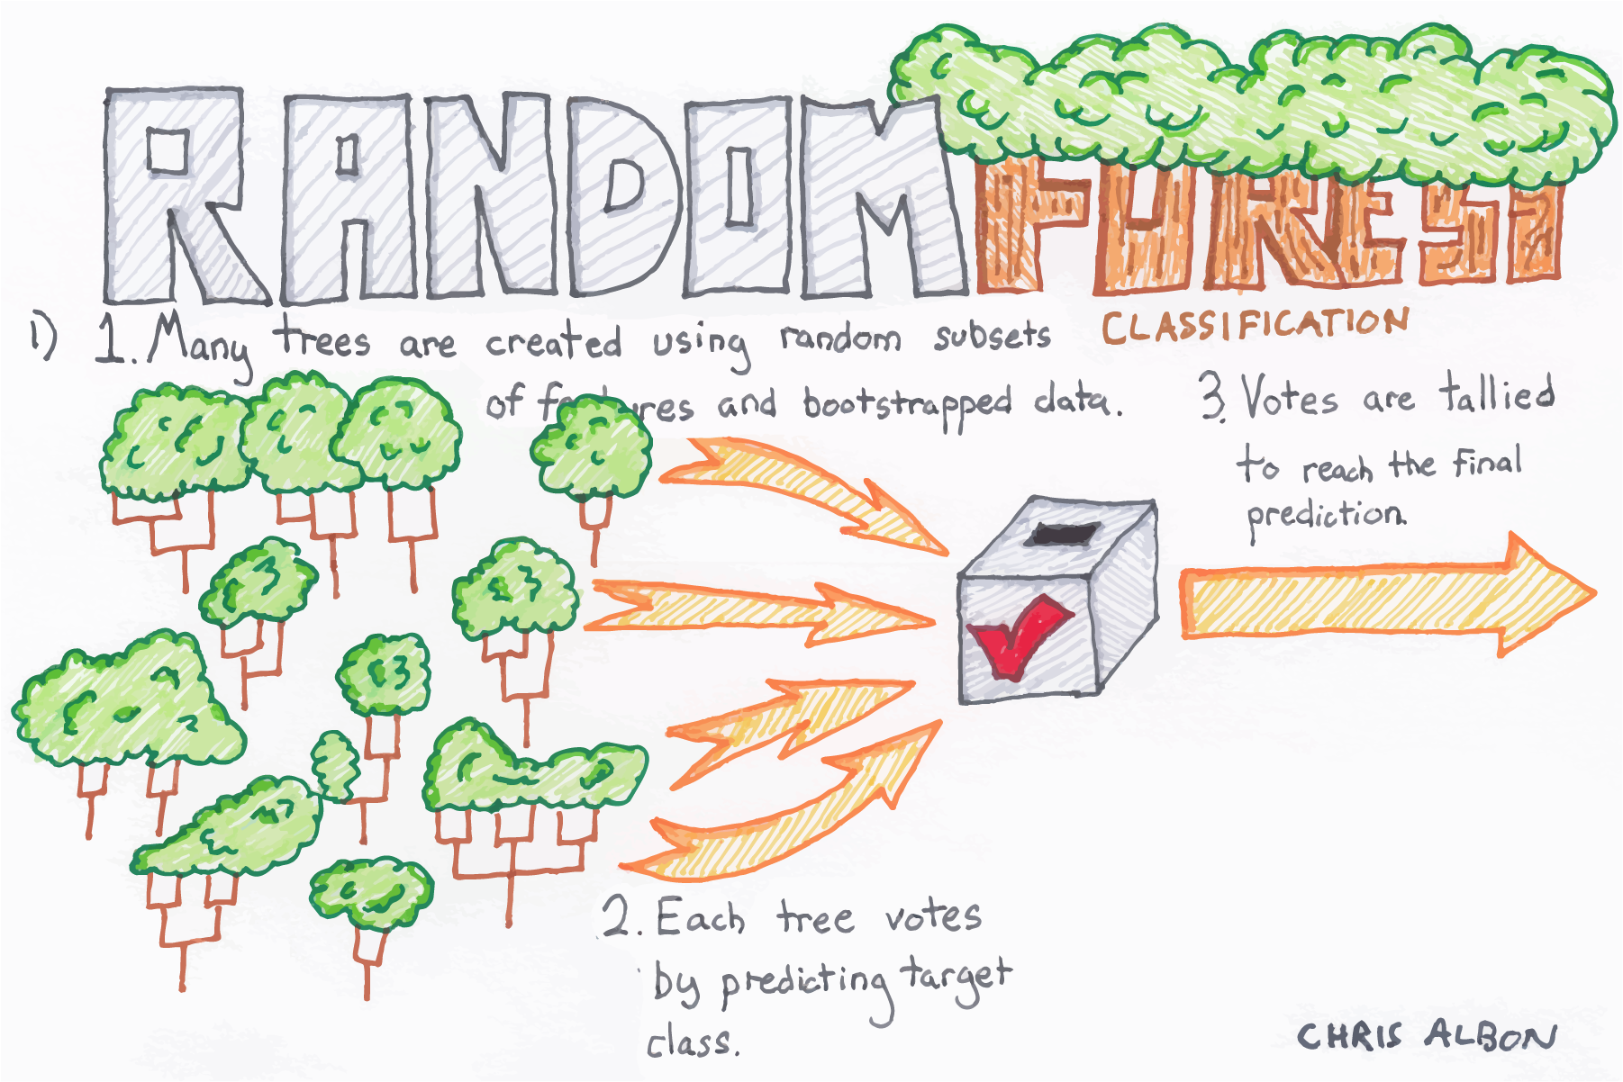

Slide 22
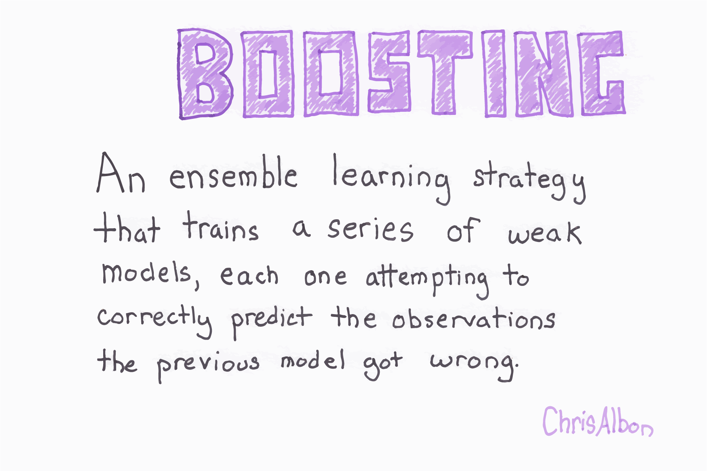

Slide 23
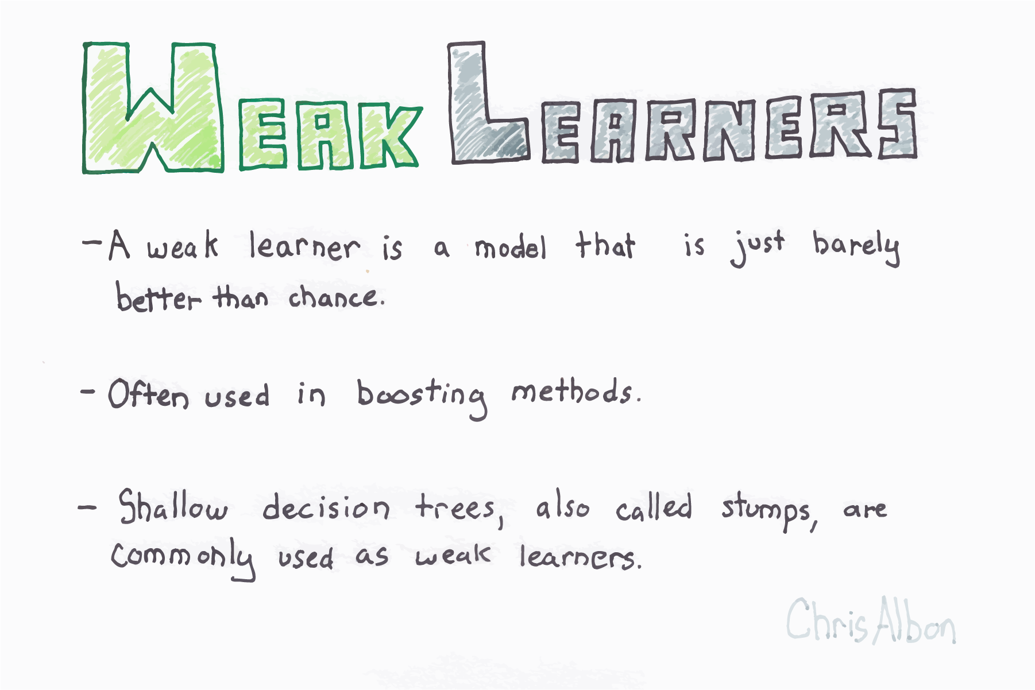

Slide 24
Boosting
Typically cannot be built in parallel (is sequential)
Tends to decrease bias

Slide 25
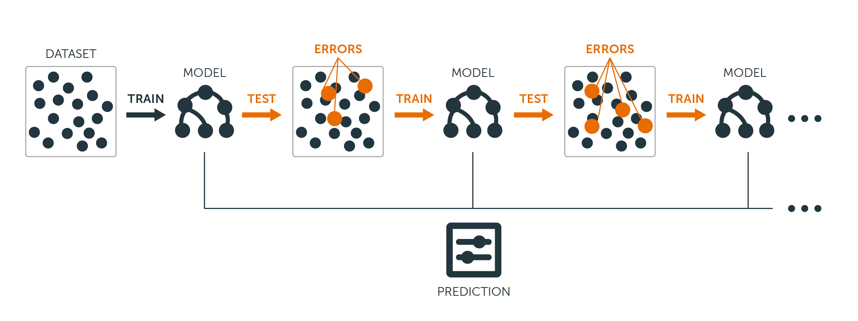
Gradient Boosted Trees/Machines
1) A short decision tree is built and errors are discovered
2) The next tree is built to focus on errors from the previous tree
3) Repeat until the hyperparameter for the number of trees is reached
4) Predictions are aggregated among trees
Credit: BigML

Slide 26
Stacking
Training Data
Classifier
Predictions
Meta-Learner
(Classifier)
Final Prediction
Classifier
Predictions
Predictions
Classifier

Slide 27
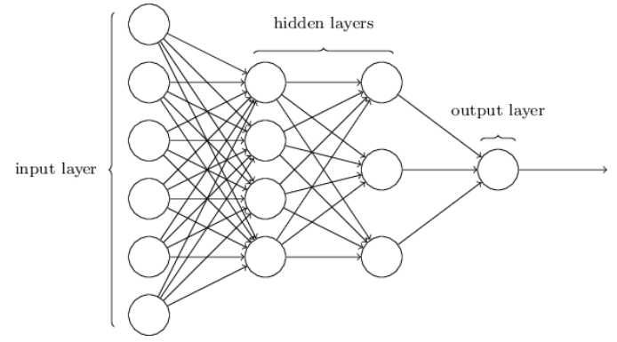
Why does that look familiar?
Neural Networks learn features from the data and have a final classifier
Stacking learns the optimal combination of base models for predictions

Slide 28




Popular Ensemble Frameworks (in Python)

Slide 29

Notebook Walkthrough
Notebook available at
https://bit.ly/2KIaLGE

Slide 30
Appendix

Slide 31
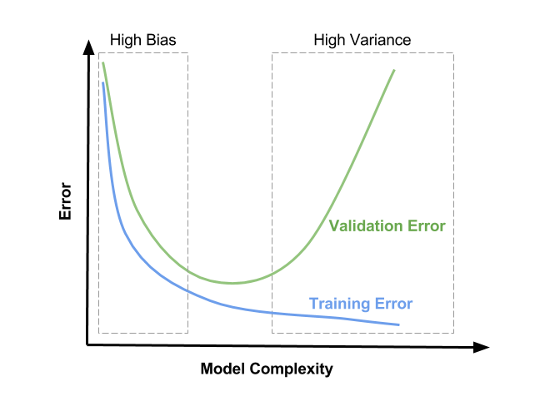
Diagnosing High Bias/Variance
Credit: Satya Mallick

